Slide 1
Memory Management

Slide 2
Background
Caching
Contiguous Memory Allocation
Paging
Virtual memory

Slide 3
Objectives
To provide a detailed description of various ways of organizing memory hardware
To discuss various memory-management techniques including contiguous memory allocation, paging and virtual memory

Slide 4
Background
Program must be brought (from disk) into memory and placed within a process for it to be run
Recall fetch-decode-execute cycle of CPU operation
Instructions and data are fetched from memory as a process executes
So memory unit sees a stream of memory addresses

Slide 5
Main memory consists of a large array of words/bytes each with its own address
Main memory and registers are only storage CPU can access directly
Register access in one CPU clock (or less)
Main memory can take many cycles – requires a transaction on the bus
Cache sits between main memory and CPU registers

Slide 6
Aside: Caching(1)
Important principle, performed at many levels in a computer (in hardware, operating system, software)
Information in use copied from slower to faster storage temporarily
Faster storage (cache) checked first to determine if information is there
If it is, information used directly from the cache (fast)
If not, data copied to cache and used there

Slide 7
Caching (2)
Cache smaller than storage being cached
Cache management important design problem
Cache size and replacement policy

Slide 8
Caching (3)
Invisible to the OS
Interacts with other memory management hardware
Processor must access memory at least once per instruction cycle
Processor execution is limited by memory cycle time
Exploit the principle of locality with a small, fast memory – cache
Principle of locality: during the course of execution of a program, memory references by the processor, for both instructions and data, tend to cluster.
Notes:
On all instruction cycles, the processor accesses memory at least once, to fetch the instruction, and often one or more additional times, to fetch operands and/ or store results. The rate at which the processor can execute instructions is clearly limited by the memory cycle time (the time it takes to read one word from or write one word to memory). This limitation has been a significant problem because of the persistent mismatch between processor and main memory speeds: Over the years, processor speed has consistently increased more rapidly than memory access speed. We are faced with a trade-off among speed, cost, and size. Ideally, main memory should be built with the same technology as that of the processor registers, giving memory cycle times comparable to processor cycle times. This has always been too expensive a strategy. The solution is to exploit the principle of locality by providing a small, fast memory between the processor and main memory, namely the cache.
During the course of execution of a program, memory references by the processor, for both instructions and data, tend to cluster. Programs typically contain a number of iterative loops and subroutines. Once a loop or subroutine is entered, there are repeated references to a small set of instructions. Similarly, operations on tables and arrays involve access to a clustered set of data bytes. Over a long period of time, the clusters in use change, but over a short period of time, the processor is primarily working with fixed clusters of memory references

Slide 9
Memory Protection
Protection of memory required to ensure correct operation
Each process must have a separate address space
To provide this, can use base and limit registers
Notes:
Protection is required to protect operating system from user processes and user processes from one another i.e. so that they are allowed only access/modify their own memory space

Slide 10
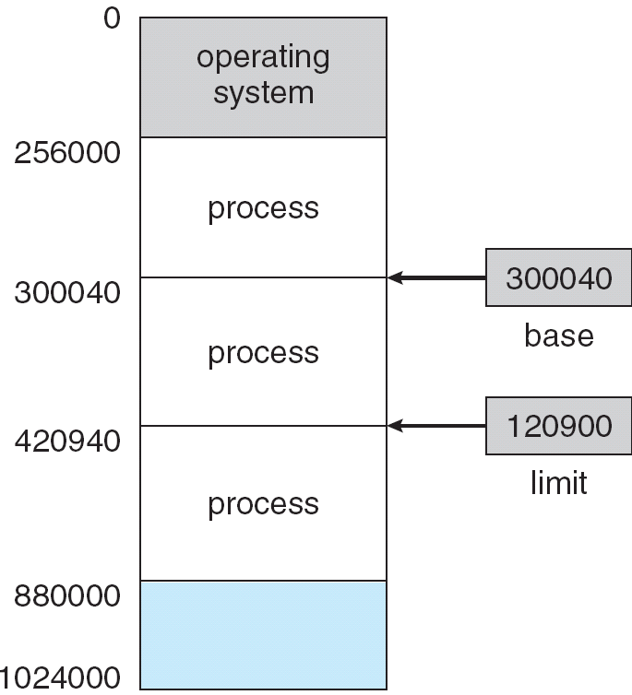
Base and Limit Registers
A pair of base and limit registers define the logical address space
Notes:
Then process can legally access all addresses from 300040 to 420939 (inclusive)

Slide 11
Address binding
Addresses may be represented in different ways:
In source code, addresses are symbolic i.e. variable name e.g. number
Compiler binds symbolic address to relocatable address e.g. 15 bytes from the beginning of the module
These relocatable addresses must be mapped to actual physical address at some stage

Slide 12
Binding of Instructions and Data to Memory
Address binding of instructions and data to memory addresses can happen at three different stages
Compile time
Load time
Execution time:
Most OS use this method
Remainder of notes assume execution time binding
Notes:
Compile time binding – if it is known where process will reside in memory, absolute addresses can be generated
Load time binding – the compiler generates relocatable addresses, at load time these are converted to absolute addresses.
Execution time binding allow for process to be moved during its execution – uses hardware device called MMU

Slide 13
Logical vs. Physical Address Space
The concept of a logical address space that is bound to a separate physical address space is central to proper memory management
13
Notes:
Logical address space is the set of all logical addresses generated by a program.
Physical address space is all the physical addresses corresponding to these logical addresses.
Usually logical address space is smaller than entire physical address space because a process has access to only a subset of memory
13

Slide 14
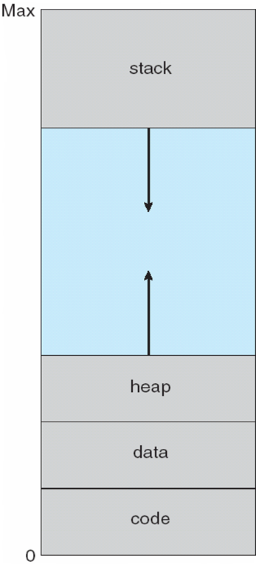
Logical Address Space

Slide 15
15
Logical address – generated by the CPU; also referred to as virtual address – usually in the range 0 to Max
Physical address – address seen by the memory unit – usually in the range R+0 to R+Max (for base value R)
Notes:
15

Slide 16
logical (virtual) and physical addresses differ when address binding is done at execution time

Slide 17
Memory-Management Unit (MMU)
Hardware device that maps logical address to physical address
An extension of base-limit register scheme
In MMU scheme, the value in the relocation register is added to every address generated by a user process at the time it is sent to memory
The user program deals with logical addresses; it never sees the real physical addresses
17
Notes:
The MMU does the run-time mapping from virtual addresses to physical addresses
17

Slide 18
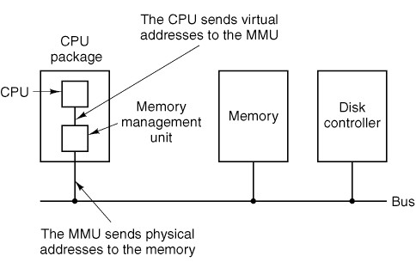
The position and function of the MMU.
Here the MMU is shown as being a part of the CPU chip because it commonly is nowadays.
However, logically it could be a separate chip and was in years gone by.

Slide 19
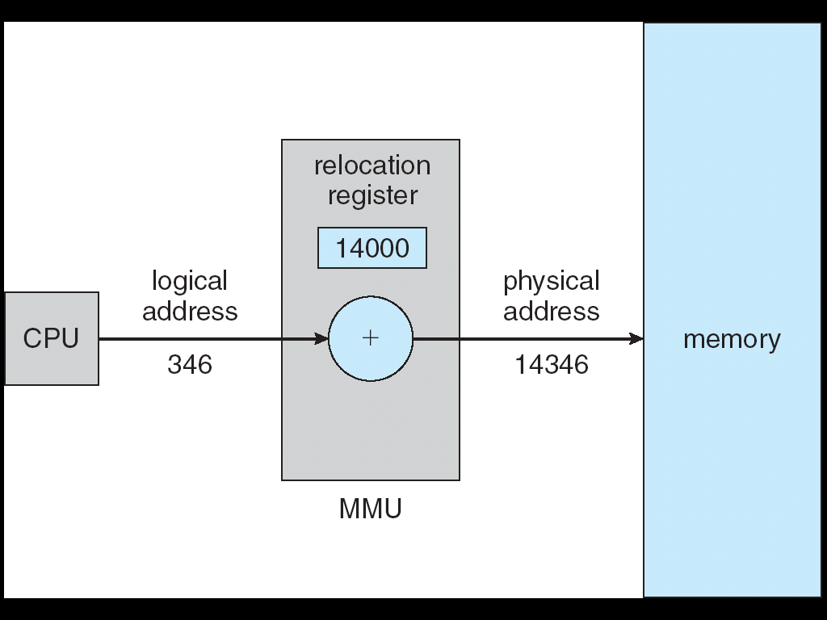
Dynamic relocation using a relocation register
Base register now called relocation register

Slide 20
Contiguous Allocation
Main memory usually divided into two partitions:
Resident operating system, usually held in low memory with interrupt vector
User processes then held in high memory
Memory must be allocated in the most efficient way possible
One method is contiguous memory allocation – each process in contained in contiguous section of memory
Notes:
The interrupt vector is a table containing the addresses of the interrupt handlers for the various devices. The CPU gets a number on the address lines which is used as an index into the interrupt vector
Modern memory managers use some form of contiguous allocation (variable partitioning). However memory is usually allocated in fixed-size blocks called pages.

Slide 21
Contiguous Allocation (Cont.)
As processes enter the system, they are put into input queue
Processes are allocated memory by OS
When process terminates, the memory is released and can be reallocated
OS
OS
OS
OS
process 5
process 5
process 5
process 5
process 9
process 9
process 8
process 10
process 2
process 2
process 2
process 2

Slide 22
At any given time, available memory comprises a set of holes of various sizes scattered throughout memory
Hole – block of available memory
When a process arrives, it is allocated memory from a hole large enough to accommodate it
Operating system maintains information about:
allocated blocks
free blocks (holes)

Slide 23
Dynamic Storage-Allocation Problem
How to satisfy a request of size n from a list of free holes
First-fit: Allocate the first hole that is big enough
Best-fit: Allocate the smallest hole that is big enough; must search entire list, unless ordered by size
Produces the smallest leftover hole
Worst-fit: Allocate the largest hole; must also search entire list
Produces the largest leftover hole
First-fit and best-fit better than worst-fit in terms of speed and storage utilization – first-fit is fastest
Notes:
Best-fit can result in memory wastage because it fills memory up with useless holes
Worst fit overcomes this problem

Slide 24
Problem:
Assume memory has the following holes (free blocks) in order:
10K, 30K, 5K, 20K, 15K, 20K
How would the following algorithms place processes of 20K, 10K, 5K (in that order):
First-fit
Best-fit
Worst-fit

Slide 25
Fragmentation
As time goes on, memory becomes more and more fragmented - External Fragmentation
Situation can occur where total memory space exists to satisfy a request, but it is not contiguous
Reduce external fragmentation by compaction
Shuffle memory contents to place all free memory together in one large block
Compaction is possible only if relocation is dynamic, and is done at execution time
Compaction may be costly in terms of time
I/O problem
Fix process in memory while it is involved in I/O
Do I/O only into OS buffers
Notes:
Simplest compaction algorithm is to move all processes towards one end of memory, all holes in the other direction, producing one large hole of available memory. This scheme can be expensive.
I/O problem
Process1 in memory may be blocked on I/O. Then I/O is using process1 memory for I/O buffers. So problem if process1 is swapped out and another process is swapped into its memory.
Solution:
do not swap out a process blocked on I/O
Or
2. Do I/O into OS buffers. Then when process is swapped bask into memory, copy OS buffers into process memory.

Slide 26
Paging
Physical address space of a process can be noncontiguous
process is allocated physical memory wherever the latter is available
This avoids external fragmentation and the need for compaction

Slide 27
Divide physical memory into fixed-sized blocks called frames
frame size is power of 2, typically between 512 bytes (1/2 KB) and 8,192 bytes (8 KB)
Divide logical memory into blocks of same size called pages
OS must keep track of all free frames
To run a program of size n pages, need to find n free frames and load program
Set up a page table to translate logical to physical addresses
Internal fragmentation will occur unless the memory required by a process corresponds to an exact multiple of frame size

Slide 28
Address Translation Scheme
Address generated by CPU is divided into:
Page number (p) – used as an index into a page table which contains base address of each page in physical memory
Page offset (d) – combined with base address to define the physical memory address that is sent to the memory unit
For given logical address space 2^{m} and page size 2^{n}
page number
page offset
p
d
m - n
n
Notes:
The page size is a power of 2. Thus if a logical address has m bits, and the page size is 2^{n} bytes, n bits of an address specify the offset within a page and the remaining m-n bits specify the page number

Slide 29
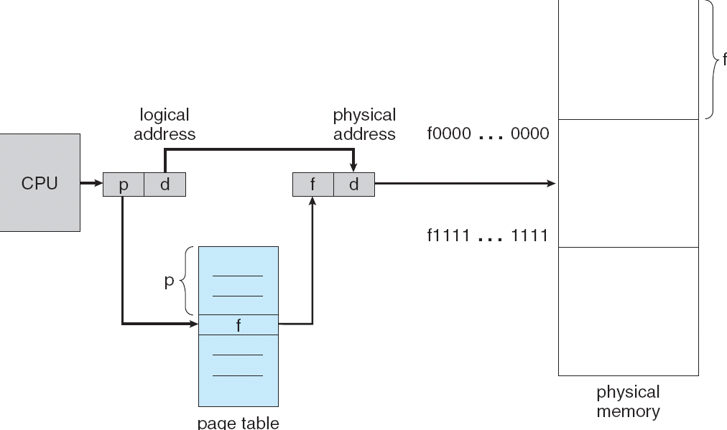
Paging Hardware

Slide 30
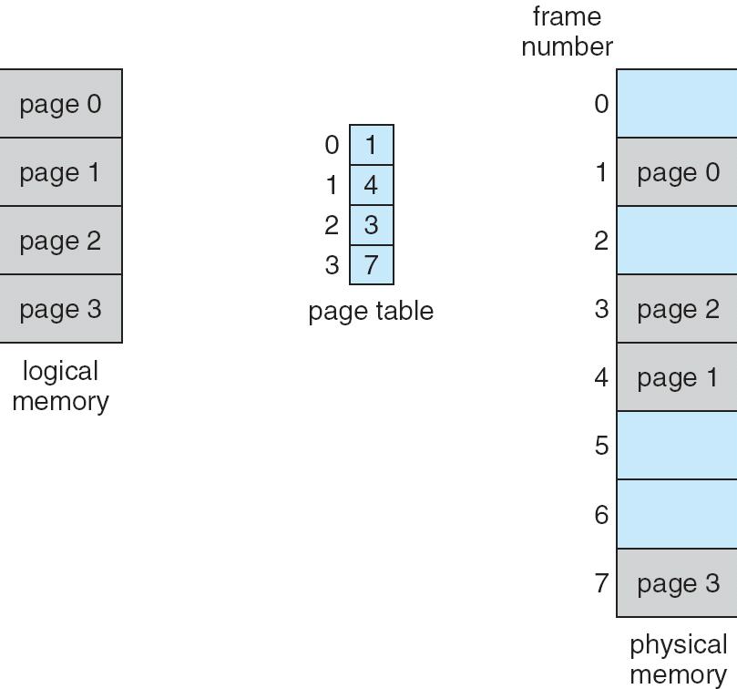
Paging Model of Logical and Physical Memory
Notes:
Paging is a form of dynamic relocation where every logical address is bound by paging hardware to some physical address. Using paging is similar to using a table of base (or relocation) registers, one for each frame of memory

Slide 31
When a new process arrives to be executed, OS examines its size (in pages)
Each page needs one frame
If there are enough free frames in memory, these are allocated to the new process
Process is loaded into these frames
Frame numbers are put into the page table for that process

Slide 32
OS must know which frames are allocated and which are available
OS maintains a list of allocated frames and a list of free frames

Slide 33
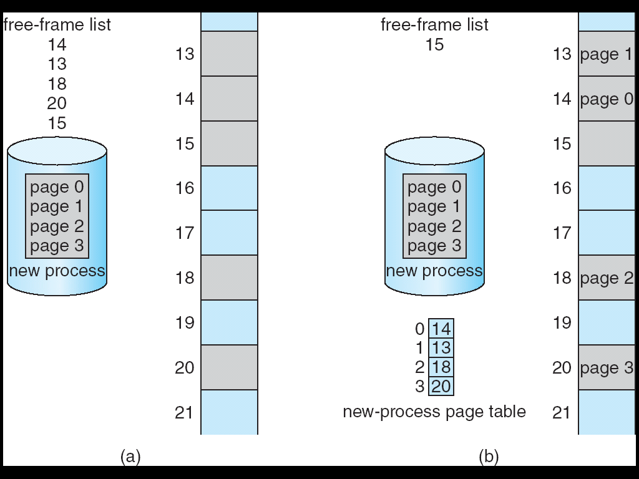
Free Frames
Before allocation
After allocation

